Slide 1
Creating an SRS
Use cases, requirements, use case diagrams, prototypes

Slide 2
What is a Requirement?
Requirements are a usable representation of a need
Requirements are specifications of what to build
The requirements for a system are the descriptions of what the system should do— the services that it provides and the constraints on its operation
Requirements do not explain how to build our system

Slide 3
Why do we need to have requirements?
They help …
Understand precisely what is required of the software
Communicate this understanding precisely to all development parties
Control production to ensure that system meets specs (including changes)

Slide 4
Classification and identification of requirements
Functional Requirements- requirements describe how a product must behave, what its features and functions. Usually extracted from user stories and use cases.
Eg. A user shall be able to search the appointments lists for all clinics.
Non-functional Requirements- requirements describe the general characteristics of a system. They are also known as quality attributes.
Product requirements These requirements specify or constrain the behavior of the software
Organizational requirements These requirements are broad system requirements derived from policies and procedures in the customer’s and developer’s organization.
External requirements This broad heading covers all requirements that are derived from factors external to the system and its development process.
Eg. Medical staff shall be able to use all the system functions after four hours of training. After this training, the average number of errors made by experienced users shall not exceed two per hour of system use.

Slide 5
Use Case vs User Stories
Use case- a formal written description of the user's interaction with the software product to accomplish a goal
User Stories- are stories that describes one way in which the system might be used by an end-user

Slide 6
Writing Use Cases

Slide 8
Definition of terms
actor: an entity that acts on the system
primary actor: initiates interaction to achieve goal
supporting actor: performs sub-goals in use case
goal: action that actor wants to accomplish
user (one sitting – E.g register device) – MOST IMPORTANT
summary (multi-sitting - E.g configure users in system),
subfunction (E.g logging in, locate device in DB)
stakeholder: anyone interested in the system
supplier, stock agency, vendor
stakeholder might not "act" in any scenario

Slide 9
Continued
scope: is the extent of the system
System
Component
Organization
Level: level at which the use case is written
User
Summary
Subfunction
precondition: conditions that need to be met before the use case can happen
trigger: event that causes the use case to happen
main success scenario: The main success scenario is a case in which nothing goes wrong
Main flow of the use case
alternate scenario: section describes what can happen differently during that scenario.
Alternate possibility of the flow of the scenario
extension scenario: describes when the main scenario can not be performed due to an error

Slide 10
What makes a good usecase?
Focuses on interaction
Starts with a request from an actor to the system.
Ends with the production of all the answers to the request.
Focuses on essential behaviors, from the actor’s point of view
Does not describe internal system activities.
Does not describe the GUI in detail.
Concise, clear, accessible to non-programmers
Easy to read.
Summary fits on a page.
Main success scenario and extensions.

Slide 11
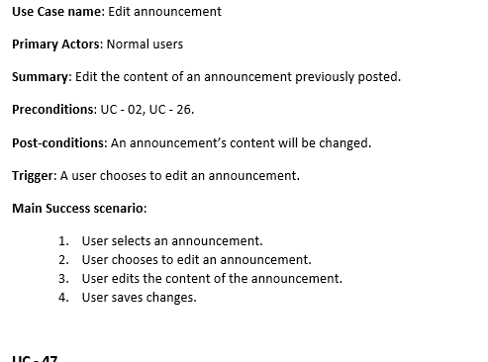
Example

Slide 12
Use case name: Change task status
Primary Actors: Project contributor
Summary: task status will be changed
Preconditions: UC – 02.
Post-conditions: task status will be changed
Trigger: the primary actor chooses to change status of the task
Main success scenario:
User chooses to change the status of the task
System will change the status of the task
Alternative scenarios:
1a. user changes task status to start
1b. user changes task status to completed
2a. system changes task status to start
2b. system changes task status to completed

Slide 13
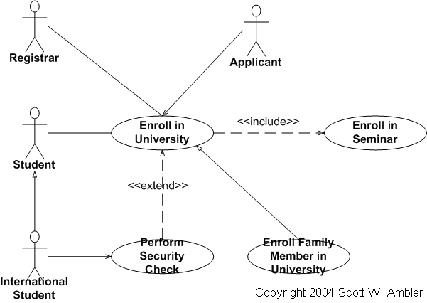
Use Case Diagram
Use case diagrams overview the usage requirements for a system. They are useful for presentations to management and/or project stakeholders

Slide 14


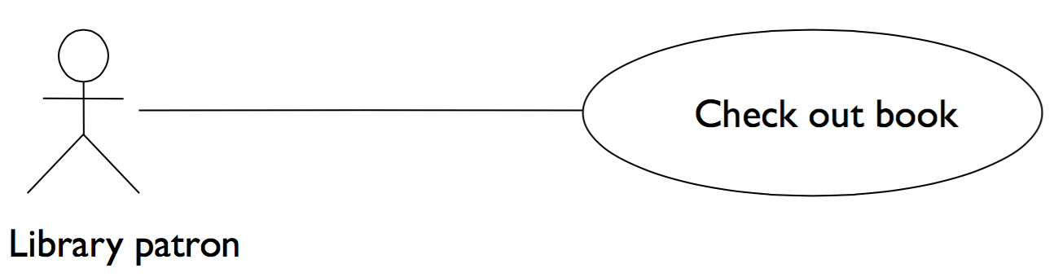
Components of Use Case Diagram
Use Case -Draw use cases using ovals. Label the ovals with verbs that represent the system's functions.
Actors -Actors are the users of a system. When one system is the actor of another system, label the actor system with the actor stereotype.
Association- Visually represented by a line. Refers to the association of an actor and a use case

Slide 15

Continued
Relationships(Usecase with usecase) -Illustrate relationships
Include- Use case include is a directed relationship between two use cases which is used to show that behavior of the included use case (the addition) is inserted into the behavior of the including (the base) use case. Needed for the use case to happen. Used for events that are in the flow of events of the source use case
Extend -Extend is a directed relationship that specifies how and when the behavior defined in usually supplementary (optional) extending use case can be inserted into the behavior defined in the extended use case. Extended use case is meaningful on its own, it is independent of the extending use case. Used for exceptional conditions, especially those that can occur at any time.

Slide 16
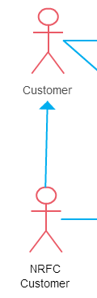
Continued
Generalization of Actors(Relationship of Actor with Actor)- Generalization of an actor means that one actor can inherit the role of the other actor. The descendant inherits all the use cases of the ancestor.

Slide 17
Prototyping
prototyping: Creating a scaled-down or incomplete version of a system to demonstrate or test its aspects.
Paper Prototype- creating a paper version of a UI
Code Prototype- writing a "rough" version of your code
UI Builder Prototype- draw a GUI visually by dragging/dropping UI controls on screen

Slide 18
Requirement Use Case Example
You are hired to develop an automatic patient monitoring system for a home-bound patient. The system is required to read out the patient’s heart rate and blood pressure and compare them against specified safe ranges. The system also has activity sensors to detect when the patient is exercising and adjust the safe ranges. In case an abnormality is detected, the system must alert a remote hospital. (Note that the measurements cannot be taken continuously, since heart rate is measured over a period of time, say 1 minute, and it takes time to inflate the blood-pressure cuff.) The system must also (i) check that the analog devices for measuring the patient’s vital signs are working correctly and report failures to the hospital; and, (ii) alert the owner when the battery power is running low

Slide 19
The system will save the number of views that each artist and album have. The number of view increments when a customer opens an artist’s biography or clicks on an album’s artwork.

